Slide 1
Assignment No. 2
Title: Polymorphism
Aim: Identify commonalities and differences between Publication, Book and Magazine classes. Title, Price, Copies are common instance variables and saleCopy is common method. The differences are, Book class has author and orderCopies(). Magazine Class has orderQty, Currentissue, reciveissue().Write a program to find how many copies of the given books are ordered and display total sale of publication.
Objectives: To learn the concept polymorphism
Theory:
What is polymorphism
Types of polymorphism
- Static polymorphism (Compile time)
- Dynamic polymorphism (Run Time)
Method Overloading with example (Static Polymorphism)
Method Overriding with example (Run time Polymorphism)
Advantages of method overriding
Rules of method overriding

Slide 2
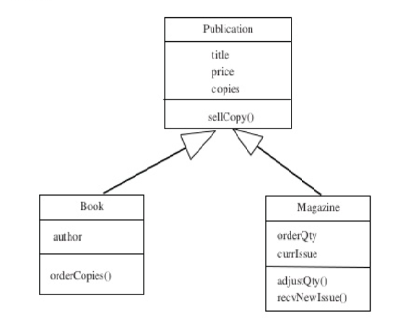
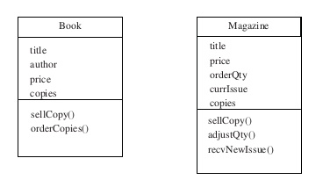
Assignment No. 2
Sample Code:
Consider Book & Magazines both specific type of publication.
Title, Price, Copies are common instance variables and saleCopy is common method.
For Book class , orderCopies() takes parameter specifying how many copies are added to stock.
For Magazine class, orderQty is number of copies received of each new issue and currIssue is date/period of
current issue.
5. Attribute title, author & price are obvious parameter. We can separate out these common member
of classes into superclass called Publication.
6. The differences will need to be specified as additional member for the ‘subclasses’ Book and
Magazine.

Slide 3
Assignment No. 2
public class Publication {
private String title;
private double price;
private int copies;
//Define constructor to assign data member
public int getcopies() {
return this.copies;
}
public void setcopies(int copies) {
this.copies = copies;
}
public void sellcopy(int qty) {
System.out.println("Total Publication sell: $" + (qty * price));
}
}
public class Book extends Publication {
private String author;
//Define constructor to assign data member
Public void ordercopies(int pcopies){
setcopies(getcopies() + pcopies);
}
//method sellcopy() of superclass Publication is overridden
public void sellcopy(int qty) {
System.out.println("Total Book sell: $" + (qty * price));
}
}
public class Magazine extends Publication {
private int orderQty;
private String currIssue;
//Define constructor to assign data member
Public void recvNewIssue(string pNewIssue){
setcopies(orderQty);
currIssue=pNewIssue;
}
//method sellcopy() of superclass Publication is overridden
public void sellcopy(int qty) {
System.out.println("Total Magazine sell: $" + (qty * price));
}
}
Class mainClass{
Public static void main(String [] args)
{
//accept all details of book to be order such as title, author, price & copies;
Book obj1 = new Book();
Obj1.ordercopies(copies);
Publication obj2 = new Book();
Obj2.sellcopy(copies); //Overriden method is invoke
Publication obj3 = new Publication();
Obj3.sellcopy(copies);
}

Slide 4
Assignment No. 2
Input:
Title: Java
Price: 200
Copies: 5
Author: XYZ
OrderQty: 1
Current Issue: March
Output:
1. Copies of given Book are order
2. Total sale of publication
Text Book referred for assignment 1
Object Oriented Programming using Java by Simon Kendal
Java The Complete Reference, Seventh Edition

Slide 5
Assignment No. 1
Frequently Ask Question:
Define is polymorphism. (BL1)
List out polymorphism types. (BL1)
Differentiate static & runtime polymorphism. (BL4)
Define method overloading. (BL1)
Define method overriding. (BL1)
Differentiate method overloading and method overriding. (BL4)
Explain superclass & subclass. (BL2)
Mapping of Course Outcomes for Assignment 1: CO3
CO1:Identify relationship among objects using inheritance and polymorphism.

